Slide 1


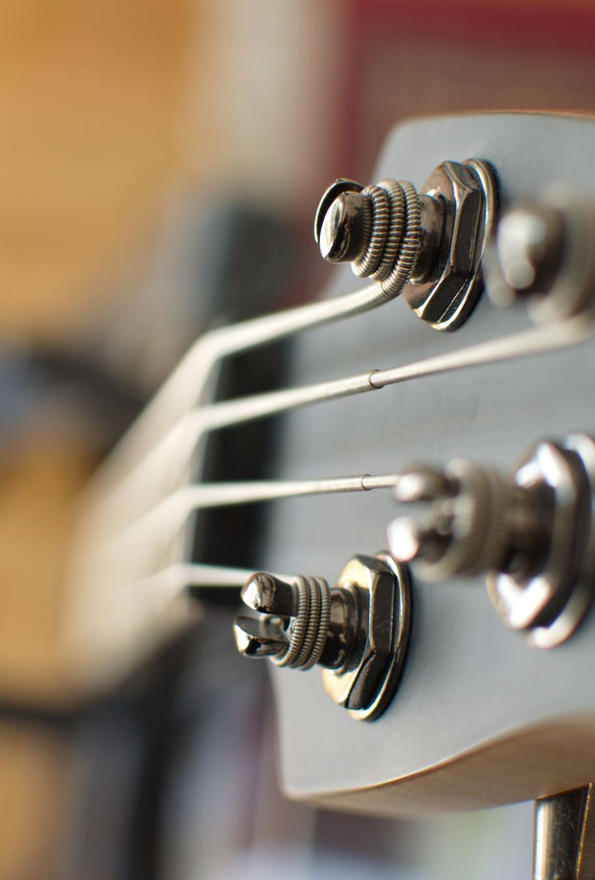
BASS BUDDY
Miguel Morell
Cristian Lagranda
Ariele Amorim

Slide 2
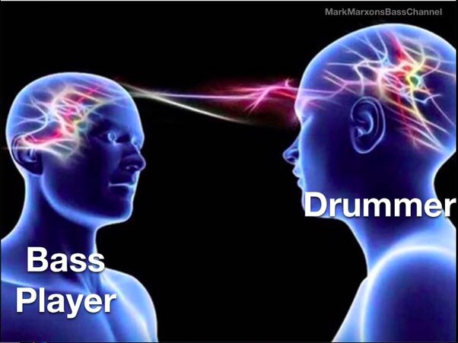
CHALLENGE
Generate bass sound to be used with drums

Slide 3
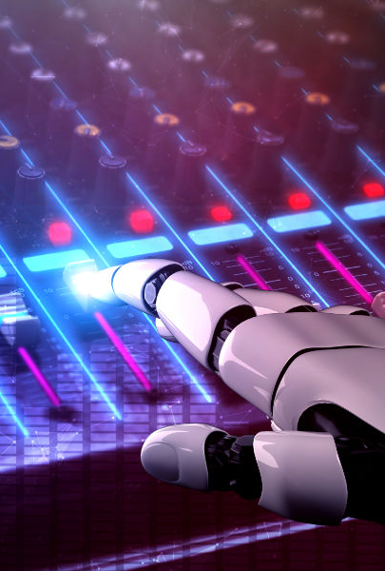
SOLUTION
Bass Buddy APP

Slide 4

HOW IT WORKS ?
User's Input
(Drums)
RNN-LSTM
MODEL
Output
(Bass & Drums)

Slide 5
THANK YOU!

